Slide 1
Estimation of the Spatial Gradient of the MR Image from the Diffusion Profile
Iman Aganj,^{1,2} Matthew Vera,¹ Thorsten Feiweier,³ Andre J. van der Kouwe,^{1,2} John E. Kirsch,^{1,2} and Bruce Fischl^{1,2}
Athinoula A. Martinos Center for Biomedical Imaging, Massachusetts General Hospital
Radiology Department, Harvard Medical School
Siemens Healthcare GmbH, Erlangen, Germany
Notes:
Hello everyone. I am going to talk about our recent project on the Estimation of the Spatial Gradient of the MR Image from the Diffusion Profile.

Slide 2
Within-voxel averaging of MR signal
$$S_{0}^{v}=\int_{v}{ρ\left(\overset{⃑}{x}\right)d\overset{⃑}{x}}$$
$S_{0}^{v}$: Proton-density MRI signal at voxel $v$
$\overset{⃑}{x}$: Particle location
$\overset{⃑}{x}$: Final location of particle
$\overset{⃑}{u}≔\overset{⃑}{x}−{\overset{⃑}{x}}_{0}$: Displacement
$ρ\left(⋅\right)$: Proton density
$$\overset{⃑}{x}$$
Notes:
The simple proton-density MR signal is proportional to the integral of the proton density inside a voxel.

Slide 3
Within-voxel averaging of MR signal
$$S_{0}^{v}=\int_{v}{w\left(\overset{⃑}{x}\right)ρ\left(\overset{⃑}{x}\right)d\overset{⃑}{x}}$$
$$={〈w〉}_{ρ}^{v}$$
$S_{0}^{v}$: T₁/T₂-weighted MRI signal at voxel $v$
$\overset{⃑}{x}$: Particle location
$\overset{⃑}{x}$: Final location of particle
$\overset{⃑}{u}≔\overset{⃑}{x}−{\overset{⃑}{x}}_{0}$: Displacement
$ρ\left(⋅\right)$: Proton density
$w\left(⋅\right)$: Relaxation-time weighting, i.e. $\left[1−\exp\left(−{TR}/{T_{1}}\right)\right]\exp\left(−{TE}/{T_{2}}\right)$
$$\overset{⃑}{x}$$
Notes:
In T1- or T2-weighted MR images, however, this integral is weighted by the relaxation-time properties of the underlying tissue, which we show with this bracket notation.

Slide 4
Within-voxel averaging in diffusion MRI
$$S^{v}\left(\overset{⃑}{q}\right)=\int_{v}{w\left({\overset{⃑}{x}}_{0}\right)ρ\left({\overset{⃑}{x}}_{0}\right)\operatorname{Pr}\left(\overset{⃑}{x} | {\overset{⃑}{x}}_{0}\right)e^{−i\overset{⃑}{q}⋅\left(\overset{⃑}{x}−{\overset{⃑}{x}}_{0}\right)}d{\overset{⃑}{x}}_{0}d\overset{⃑}{x}}$$
$$\overset{⃑}{x}$$
$S^{v}$: dMRI signal at voxel $v$
${\overset{⃑}{x}}_{0}$: Initial location of particle
$\overset{⃑}{x}$: Final location of particle
$\overset{⃑}{u}≔\overset{⃑}{x}−{\overset{⃑}{x}}_{0}$: Displacement
$ρ\left(⋅\right)$: Proton density
$w\left(⋅\right)$: Relaxation-time weighting, i.e. $\left[1−\exp\left(−{TR}/{T_{1}}\right)\right]\exp\left(−{TE}/{T_{2}}\right)$
$\overset{⃑}{q}≔γδ\overset{⃑}{G}$: q-vector
$${\overset{⃑}{x}}_{0}$$
Notes:
Diffusion MRI signal, on the other hand, includes additional weighting factors that depend on the initial and final positions of a particle.

Slide 5
Within-voxel averaging in diffusion MRI
$$S^{v}\left(\overset{⃑}{q}\right)=\int_{v}{w\left({\overset{⃑}{x}}_{0}\right)ρ\left({\overset{⃑}{x}}_{0}\right)\operatorname{Pr}\left(\overset{⃑}{x} | {\overset{⃑}{x}}_{0}\right)e^{−i\overset{⃑}{q}⋅\left(\overset{⃑}{x}−{\overset{⃑}{x}}_{0}\right)}d{\overset{⃑}{x}}_{0}d\overset{⃑}{x}}$$
$$=\int_{v}{w\left({\overset{⃑}{x}}_{0}\right)ρ\left({\overset{⃑}{x}}_{0}\right)d{\overset{⃑}{x}}_{0}}\int{\operatorname{Pr}\left(\overset{⃑}{u} | {\overset{⃑}{x}}_{0}\right)e^{−i\overset{⃑}{q}⋅\overset{⃑}{u}}d\overset{⃑}{u}}$$
$$={〈w〉}_{ρ}^{v}ℱ\left\{P\left(\overset{⃑}{u}\right)\right\}$$
$$=S_{0}^{v}{\hat{P}}^{v}\left(\overset{⃑}{q}\right)$$
$$w\left(\frac{{\overset{⃑}{x}}_{0}+\overset{⃑}{x}}{2}\right)$$
$$\overset{⃑}{x}$$
$S^{v}$: dMRI signal at voxel $v$
${\overset{⃑}{x}}_{0}$: Initial location of particle
$\overset{⃑}{x}$: Final location of particle
$\overset{⃑}{u}≔\overset{⃑}{x}−{\overset{⃑}{x}}_{0}$: Displacement
$ρ\left(⋅\right)$: Proton density
$w\left(⋅\right)$: Relaxation-time weighting, i.e. $\left[1−\exp\left(−{TR}/{T_{1}}\right)\right]\exp\left(−{TE}/{T_{2}}\right)$
$\overset{⃑}{q}≔γδ\overset{⃑}{G}$: q-vector
$$\overset{⃑}{u}$$
$$w\left({\overset{⃑}{x}}_{0}\right)$$
$${\overset{⃑}{x}}_{0}$$
$P\left(\overset{⃑}{u}\right)≔\operatorname{Pr}\left(\overset{⃑}{u}\right)≅\operatorname{Pr}\left(\overset{⃑}{u} | {\overset{⃑}{x}}_{0}\right)$: Ensemble Average Propagator (EAP)
${\hat{P}}^{v}≔ℱ\left\{P\right\}$: Fourier of EAP
Diffusion Spectrum Imaging (DSI)
(Wedeen et al, MRM’05)
Notes:
This expression can be written as a function of the displacement vector, u. In the DSI model, the probability of molecule displacement is assumed to be independent of the initial position, which we call the ensemble average propagator (EAP). With that assumption, the diffusion signal becomes a product of the non-diffusion-weighted image (S0) and the Fourier transform of the EAP. The focus of this work is on the relaxation-time weighting factor (w). In standard diffusion models, w for a diffusing molecule has been considered as its value at the initial position of the molecule. However, it would be more accurate to consider an effective value for the relaxation-time weighting that the particle experiences during diffusion. Here, we propose to use the midpoint value of w for the diffusing particle, as a more accurate approximation for the effective relaxation-time weighting.

Slide 6
First-order approximation
$$w\left(\frac{{\overset{⃑}{x}}_{0}+\overset{⃑}{x}}{2}\right)=w\left({\overset{⃑}{x}}_{0}+\frac{\overset{⃑}{u}}{2}\right)$$
$$≅w\left({\overset{⃑}{x}}_{0}\right)+∇_{x}w\left({\overset{⃑}{x}}_{0}\right)⋅\frac{\overset{⃑}{u}}{2}$$
${\overset{⃑}{x}}_{0}$: Initial location of particle
$\overset{⃑}{x}$: Final location of particle
$\overset{⃑}{u}≔\overset{⃑}{x}−{\overset{⃑}{x}}_{0}$: Displacement
$w\left(⋅\right)$: Relaxation-time weighting
Notes:
We first rewrite the midpoint value of w as a function of the displacement, then use a linear approximation of w in the vicinity of the molecule’s diffusion.

Slide 7
First-order approximation
$$S^{v}\left(\overset{⃑}{q}\right)=\int_{v}{\underbrace{\left(w\left({\overset{⃑}{x}}_{0}\right)+∇_{x}w\left({\overset{⃑}{x}}_{0}\right)⋅{\overset{⃑}{u}}/2\right)}ρ\left({\overset{⃑}{x}}_{0}\right)P\left(\overset{⃑}{u}\right)e^{−i\overset{⃑}{q}⋅\overset{⃑}{u}}d{\overset{⃑}{x}}_{0}d\overset{⃑}{u}}$$
${\overset{⃑}{x}}_{0}$: Initial location of particle
$\overset{⃑}{x}$: Final location of particle
$\overset{⃑}{u}≔\overset{⃑}{x}−{\overset{⃑}{x}}_{0}$: Displacement
$w\left(⋅\right)$: Relaxation-time weighting
$S^{v}$: dMRI signal at voxel $v$
$ρ\left(⋅\right)$: Proton density
$\overset{⃑}{q}≔γδ\overset{⃑}{G}$: q-vector
$P\left(\overset{⃑}{u}\right)$: Ensemble Average Propagator (EAP)
${\hat{P}}^{v}≔ℱ\left\{P\right\}$: Fourier of EAP
Notes:
Now we use this linear approximation in the expression for the diffusion signal.

Slide 8
First-order approximation
$$S^{v}\left(\overset{⃑}{q}\right)=\int_{v}{\left(w\left({\overset{⃑}{x}}_{0}\right)+∇_{x}w\left({\overset{⃑}{x}}_{0}\right)⋅{\overset{⃑}{u}}/2\right)ρ\left({\overset{⃑}{x}}_{0}\right)P\left(\overset{⃑}{u}\right)e^{−i\overset{⃑}{q}⋅\overset{⃑}{u}}d{\overset{⃑}{x}}_{0}d\overset{⃑}{u}}$$
$$=S_{1}^{v}\left(\overset{⃑}{q}\right)+S_{2}^{v}\left(\overset{⃑}{q}\right)$$
$$S_{1}^{v}\left(\overset{⃑}{q}\right)=\int_{v}{w\left({\overset{⃑}{x}}_{0}\right)ρ\left({\overset{⃑}{x}}_{0}\right)d{\overset{⃑}{x}}_{0}}\int{P\left(\overset{⃑}{u}\right)e^{−i\overset{⃑}{q}⋅\overset{⃑}{u}}d\overset{⃑}{u}}={〈w〉}_{ρ}^{v}ℱ\left\{P\left(\overset{⃑}{u}\right)\right\}=S_{0}^{v}{\hat{P}}^{v}\left(\overset{⃑}{q}\right)$$
$$S_{2}^{v}\left(\overset{⃑}{q}\right)=\frac{1}{2}\int_{v}{∇_{x}w\left({\overset{⃑}{x}}_{0}\right)ρ\left({\overset{⃑}{x}}_{0}\right)d{\overset{⃑}{x}}_{0}}⋅\int{\overset{⃑}{u}P\left(\overset{⃑}{u}\right)e^{−i\overset{⃑}{q}⋅\overset{⃑}{u}}d\overset{⃑}{u}}$$
$$=\frac{1}{2}{〈∇_{x}w〉}_{ρ}^{v}⋅ℱ\left\{\overset{⃑}{u}P\left(\overset{⃑}{u}\right)\right\}$$
$$=\frac{i}{2}{〈∇_{x}w〉}_{ρ}^{v}⋅∇_{q}{\hat{P}}^{v}\left(\overset{⃑}{q}\right)$$
${\overset{⃑}{x}}_{0}$: Initial location of particle
$\overset{⃑}{x}$: Final location of particle
$\overset{⃑}{u}≔\overset{⃑}{x}−{\overset{⃑}{x}}_{0}$: Displacement
$w\left(⋅\right)$: Relaxation-time weighting
$S^{v}$: dMRI signal at voxel $v$
$ρ\left(⋅\right)$: Proton density
$\overset{⃑}{q}≔γδ\overset{⃑}{G}$: q-vector
$P\left(\overset{⃑}{u}\right)$: Ensemble Average Propagator (EAP)
${\hat{P}}^{v}≔ℱ\left\{P\right\}$: Fourier of EAP
Notes:
This gives us two terms. The first term is the zero-order term that we originally used. The second term, however, is the product of an integral of the gradient of w and an integral of u times the EAP, which is the mean gradient of w times the Fourier of u times EAP, and, from the Fourier theory, reduces to i times gradient of the Fourier of the EAP with respect to the q-vector.

Slide 9
First-order approximation
$$S^{v}\left(\overset{⃑}{q}\right)=S_{0}^{v}{\hat{P}}^{v}\left(\overset{⃑}{q}\right)+\frac{i}{2}{〈∇_{x}w〉}_{ρ}^{v}⋅∇_{q}{\hat{P}}^{v}\left(\overset{⃑}{q}\right)$$
$S^{v}$: dMRI signal at voxel $v$
$ρ\left(⋅\right)$: Proton density
$\overset{⃑}{q}≔γδ\overset{⃑}{G}$: q-vector
$P\left(\overset{⃑}{u}\right)$: Ensemble Average Propagator (EAP)
${\hat{P}}^{v}≔ℱ\left\{P\right\}$: Fourier of EAP
$w\left(⋅\right)$: Relaxation-time weighting
Notes:
Assuming a symmetric EAP, the diffusion signal now has an imaginary term that can be used to microscopically estimate the gradient of the relaxation-time property of the tissue, which can potentially be useful as a biomarker itself.

Slide 10
Up-sampling
$$S^{v}\left(\overset{⃑}{q}\right)=S_{0}^{v}{\hat{P}}^{v}\left(\overset{⃑}{q}\right)+\frac{i}{2}{〈∇_{x}w〉}_{ρ}^{v}⋅∇_{q}{\hat{P}}^{v}\left(\overset{⃑}{q}\right)$$
$S^{v}$: dMRI signal at voxel $v$
$ρ\left(⋅\right)$: Proton density
$\overset{⃑}{q}≔γδ\overset{⃑}{G}$: q-vector
$P\left(\overset{⃑}{u}\right)$: Ensemble Average Propagator (EAP)
${\hat{P}}^{v}≔ℱ\left\{P\right\}$: Fourier of EAP
$w\left(⋅\right)$: Relaxation-time weighting
Notes:
This term can also provide a relationship that is potentially useful for diffusion MRI super-resolution.

Slide 11
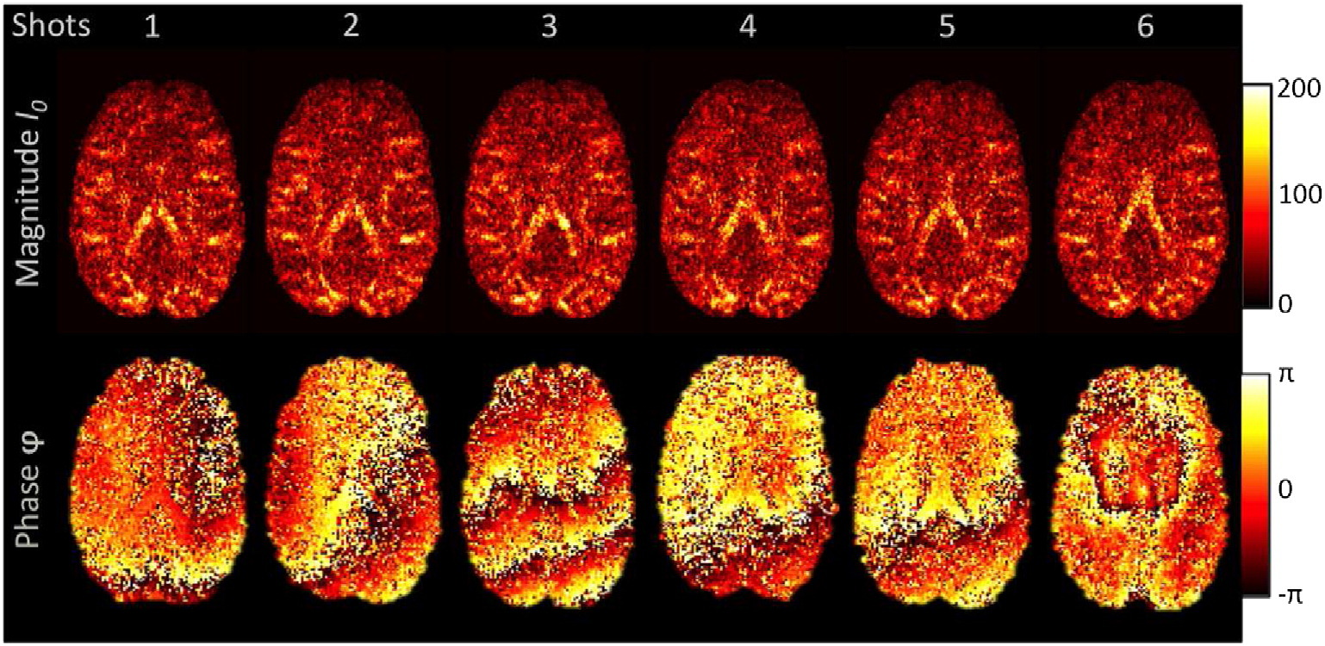
Using the phase image?
$$S^{v}\left(\overset{⃑}{q}\right)=S_{0}^{v}{\hat{P}}^{v}\left(\overset{⃑}{q}\right)+\frac{i}{2}{〈∇_{x}w〉}_{ρ}^{v}⋅∇_{q}{\hat{P}}^{v}\left(\overset{⃑}{q}\right)$$
(Eichner et al, NeuroImage’15)
$S^{v}$: dMRI signal at voxel $v$
$ρ\left(⋅\right)$: Proton density
$\overset{⃑}{q}≔γδ\overset{⃑}{G}$: q-vector
$P\left(\overset{⃑}{u}\right)$: Ensemble Average Propagator (EAP)
${\hat{P}}^{v}≔ℱ\left\{P\right\}$: Fourier of EAP
$w\left(⋅\right)$: Relaxation-time weighting
Notes:
To estimate this gradient of w, one may want to use the phase of the image to measure the imaginary part of the signal; however, as can be seen in this figure, the phase is not reproducible or reliable for this purpose.

Slide 12
Magnitude image
$$S^{v}\left(\overset{⃑}{q}\right)=S_{0}^{v}{\hat{P}}^{v}\left(\overset{⃑}{q}\right)+\frac{i}{2}{〈∇_{x}w〉}_{ρ}^{v}⋅∇_{q}{\hat{P}}^{v}\left(\overset{⃑}{q}\right)$$
$$\left|S^{v}\left(\overset{⃑}{q}\right)\right|=S_{0}^{v}{\hat{P}}^{v}\left(\overset{⃑}{q}\right)\sqrt{1+{\left(\frac{{〈∇_{x}w〉}_{ρ}^{v}⋅∇_{q}{\hat{P}}^{v}\left(\overset{⃑}{q}\right)}{2S_{0}^{v}{\hat{P}}^{v}\left(\overset{⃑}{q}\right)}\right)}^{2}}$$
$$\left|S^{v}\left(\overset{⃑}{q}\right)\right|=S_{0}^{v}{\hat{P}}^{v}\left(\overset{⃑}{q}\right)\sqrt{1+{\left(\frac{{〈∇_{x}w〉}_{ρ}^{v}}{S_{0}^{v}}⋅\frac{1}{2}∇_{q}\log{{\hat{P}}^{v}\left(\overset{⃑}{q}\right)}\right)}^{2}}$$
$$DTI: \frac{1}{2}∇_{q}\log{{\hat{P}}^{v}\left(\overset{⃑}{q}\right)}=−τD^{v}\overset{⃑}{q}$$
$D^{v}$: Diffusion tensor
$τ=Δ−δ/3$: Diffusion time
$S^{v}$: dMRI signal at voxel $v$
$ρ\left(⋅\right)$: Proton density
$\overset{⃑}{q}≔γδ\overset{⃑}{G}$: q-vector
$P\left(\overset{⃑}{u}\right)$: Ensemble Average Propagator (EAP)
${\hat{P}}^{v}≔ℱ\left\{P\right\}$: Fourier of EAP
$w\left(⋅\right)$: Relaxation-time weighting
Notes:
The magnitude of the signal, however, is reliable and can be used to estimate the gradient of w. By rewriting the new factor in terms of the log of the Fourier of the EAP, one can see that using the diffusion tensor imaging model simplifies the formula.

Slide 13
Magnitude image
$$DTI:$$
$$\left|S^{v}\left(\overset{⃑}{q}\right)\right|=S_{0}^{v}e^{−τ{\overset{⃑}{q}}^{T}D^{v}\overset{⃑}{q}}\sqrt{1+{\left(τ{\frac{{〈∇_{x}w〉}_{ρ}^{v}}{S_{0}^{v}}}^{T}D^{v}\overset{⃑}{q}\right)}^{2}}$$
$D^{v}$: Diffusion tensor
$τ=Δ−δ/3$: Diffusion time
$w\left(⋅\right)$: Relaxation-time weighting
$S^{v}$: dMRI signal at voxel $v$
$ρ\left(⋅\right)$: Proton density
$\overset{⃑}{q}≔γδ\overset{⃑}{G}$: q-vector
Notes:
We used the DTI model in our experiments and estimated the 6 parameters of the diffusion tensor and the three elements of the mean gradient of w by fitting the signal to this formula using the pattern search algorithm.

Slide 14
Effect Size
$$τ{\left\|\frac{{〈∇_{x}w〉}_{ρ}^{v}}{S_{0}^{v}}\right\|}_{2}^{2}\left\|D^{v}\right\|$$
$$={10}^{−3}\sim {10}^{−4}$$
Stimulated-Echo dMRI → $τ>1 sec.$
$D^{v}$: Diffusion tensor
$τ=Δ−δ/3$: Diffusion time
$w\left(⋅\right)$: Relaxation-time weighting
$S^{v}$: dMRI signal at voxel $v$
$ρ\left(⋅\right)$: Proton density
Notes:
The effect size, that is the relative change that the new model brings to the log of the diffusion signal, can be seen to be related to the diffusion time, voxel size, and tissue diffusivity, and is quite small for a typical diffusion MRI scan. By using the stimulated-echo sequence, however, a longer diffusion time and therefore a larger effect can be achieved.

Slide 15
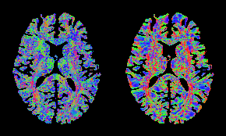
Results: Human Connectome Project (in vivo)
Orientation of estimated gradient
Using the proposed model
Using the finite element approach
Notes:
Here you can see the color-coded orientation of the gradient of the image. On the left, we used the proposed model, and on the right, we estimated the gradient from the image itself using the finite-element approach. Some similarities can be seen, especially in single-fiber regions where the DTI model is valid.

Slide 16
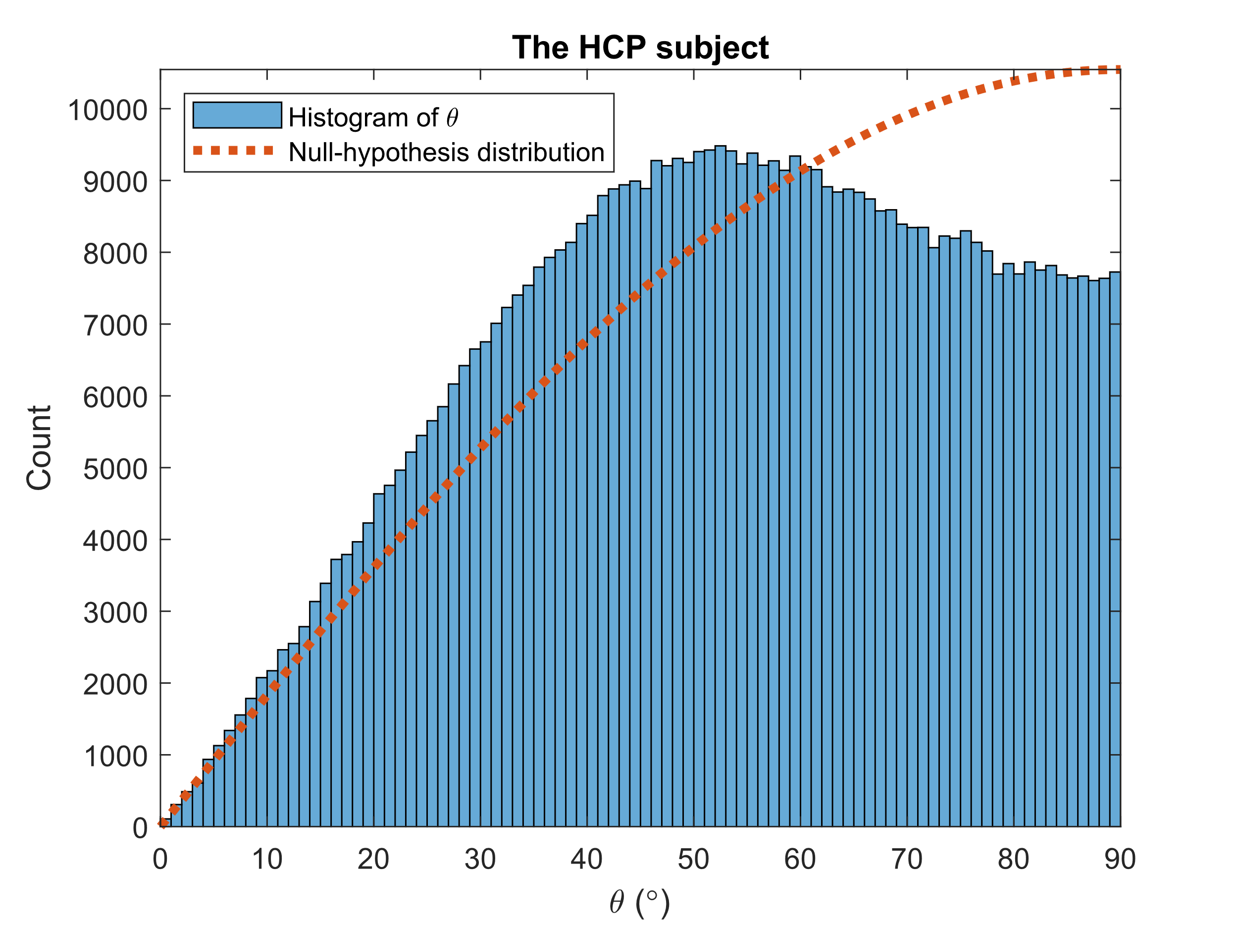
Results: Human Connectome Project (in vivo)
$θ:$ acute angle between the orientations estimated using the proposed model and using the finite element approach
Notes:
The distribution of the acute angle between the two orientations, shown in blue, demonstrates a significantly smaller angle than predicted by chance, shown in red, meaning that the estimated gradient is related to the actual image gradient.

Slide 17
Results: Acquired Stimulated-Echo dMRI (ex vivo)
Acquired with $τ=1$ sec., 256 diffusion directions with b=1000 s/mm², 8 repetitions, 320 b=0 images, isotropic voxel size of 2 mm.
Notes:
We also tried the estimation on a stimulated-echo diffusion image that we acquired from an ex vivo brain with the long diffusion time of 1 second. We observed the same effect, however less significant, possibly due to the low signal-to-noise ratio of the image.

Slide 18
Estimation of the Spatial Gradient of the MR Image from the Diffusion Profile
New diffusion MRI model, potentially useful to:
Creation of MRI biomarkers
Super-resolution
Need for further validation:
Confounding factor of “fiber continuity”
I. Aganj, M. Vera, T. Feiweier, A. J. van der Kouwe, J. E. Kirsch, and B. Fischl, “Estimation of the spatial gradient of the MR image from the diffusion profile,” in Proc. ISMRM & ISMRT 2023 Annual Meeting & Exhibition, Toronto, Canada, 2023.
Notes:
In conclusion, we have presented a new approach to estimating the spatial gradient of the image from the diffusion signal, which may potentially be useful in biomarker creation and super-resolution. A confounding factor that can also create such a relationship is “fiber continuity”, which is a characteristic of fibrous tissue. Therefore, we need further validation to ensure that the results that we see are indeed due to our MR physics hypothesis.

Slide 19
Thank You!
http://iman.mgh.harvard.edu
Notes:
Thank you very much for your attention!

