Slide 1
Segmentation-Free Measurement of Cortical Thickness from MRI by Minimum Line Integrals
Iman Aganj,¹ Guillermo Sapiro,¹ Neelroop Parikshak,² Sarah K. Madsen,² and Paul M. Thompson²
Department of Electrical and Computer Engineering, University of Minnesota
Laboratory of Neuro Imaging, University of California - Los Angeles

Slide 2
Importance of Cortical Thickness
Childhood development
Progression of diseases (Alzheimer’s, AIDS, epilepsy)
Quantify treatment effects, drug trials
P. M. Thompson et al, “Abnormal cortical complexity and thickness profiles mapped in Williams syndrome,” J. Neuroscience, vol. 25, no. 16, pp. 4146–4158, Apr. 2005.
P. M. Thompson et al, “Mapping cortical change in Alzheimer’s disease, brain development, and schizophrenia,” NeuroImage, vol. 23, pp. 2–18, Sep. 2004.

Slide 3
Previous Work
B. Fischl and A. M. Dale, “Measuring the thickness of the human cerebral cortex from magnetic resonance images,” Proc. Nat. Acad. Sci., vol. 97, no. 20, pp. 11 050–11 055, 2000.
D. MacDonald, N. Kabani, D. Avis, and A. C. Evans, “Automated 3-D extraction of inner and outer surfaces of cerebral cortex from MRI,” NeuroImage, vol. 12, pp. 340–356, 2000.
M. I. Miller, A. B. Massie, J. T. Ratnanather, K. N. Botteron, and J. G. Csernansky, “Bayesian construction of geometrically based cortical thickness metrics,” NeuroImage, vol. 12, pp. 676–687, 2000.
M. L. J. Scott and N. A. Thacker, “Cerebral cortical thickness measurements,” Imaging Science and Biomedical Engineering Division, University of Manchester, Manchester, England, TINA Memo 2004-007, 2004.
S. E. Jones, B. R. Buchbinder, and I. Aharon, “Three-dimensional mapping of the cortical thickness using Laplace's equation,” Hum. Brain Mapping, vol. 11, pp. 12–32, 2000.
A. J. Yezzi and J. L. Prince, “An Eulerian PDE approach for computing tissue thickness,” IEEE Trans. Med. Imag., vol. 22, pp. 1332–1339, Oct. 2003.
H. Haidar, J. S. Soul, “Measurement of cortical thickness in 3D brain MRI data: Validation of the Laplacian method,” NeuroImage, vol. 16, pp. 146–153, 2006.
N. Thorstensen, M. Hofer, G. Sapiro, H. Pottmann, “Measuring cortical thickness from volumetric MRI data,” unpublished, 2006.
S. Pizer, D. Eberly, D. Fritsch, and B. Morse, “Zoom-invariant vision of figural shape: The mathematics of cores,” Comput. Vision Image Understanding, vol. 69, no. 1, pp. 55-71, 1998.
Mostly based on pre-segmentation
Information is discarded and not used in measurement.
Voxel misclassification results in considerable error.

Slide 4
Intuitive Method

Slide 5
Intuitive Method

Slide 6
Minimizing Line Integral

Slide 7
Minimizing Line Integral

Slide 8

Minimizing Line Integral

Slide 9
Minimizing Line Integral

Slide 10
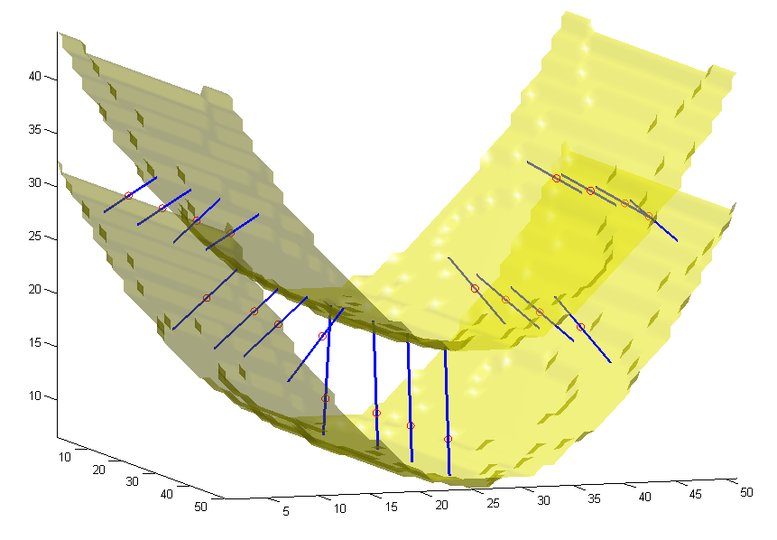
Minimizing Line Integral

Slide 11
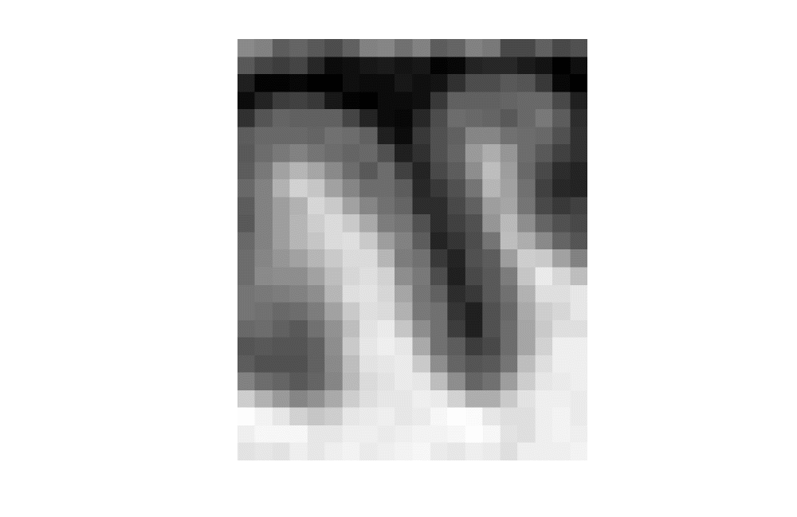
MRI Data
CSF
GM
WM

Slide 12
Stopping Conditions

Slide 13
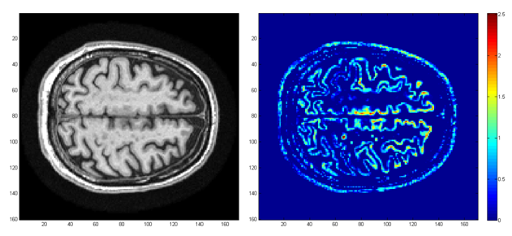
Experimental Results

Slide 14
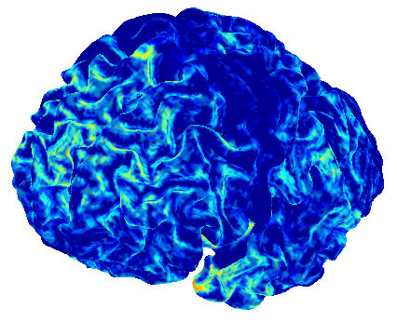
Experimental Results

Slide 15
Computing the Skeleton
t(x)=t₁(x)+t₂(x)
x
|t₁(x)-t₂(x)| < 0.5
P(x) > 0.4
t₁(x)
t₂(x)

Slide 16
Experimental Results
 | Alzheimer’s Disease | Normal Subject
Number of subjects | 9 | 13
Mean change | -1.42 % | -0.19 %
SD of change | 3.52 | 3.39
Group separation | 0.36
Group separation = (Mean for Normal - Mean for AD) / (SD for all)

Slide 17
Experimental Results
 | Proposed Method | FreeSurfer*
Paired Student’s t for AD | t = -1.20 p = 0.001 | t = -1.50 p = 0.001
Paired Student’s t for Normal | t = -0.27 p = 0.009 | t = +0.18 p = 0.001
Group separation | 0.36 | 0.50
Pearson’s r | r = 0.58 , p = 0.003
* B. Fischl and A. M. Dale, “Measuring the thickness of the human cerebral cortex from magnetic resonance images,” Proc. Nat. Acad. Sci., vol. 97, no. 20, pp. 11 050–11 055, 2000.

Slide 18
THANK YOU!
iman@umn.edu

