Slide 1


Autism is characterized in part by:
- enhanced (or preserved) ability to attend to local details
- impaired ability to integrate the local context.
Hypotheses:
Global processing trials will be right hemisphere lateralized where as local trials will be lateralized to the left hemisphere
Incongruent trials will require response inhibition and recruit more cognitive processing regions (frontal, etc).

Slide 2
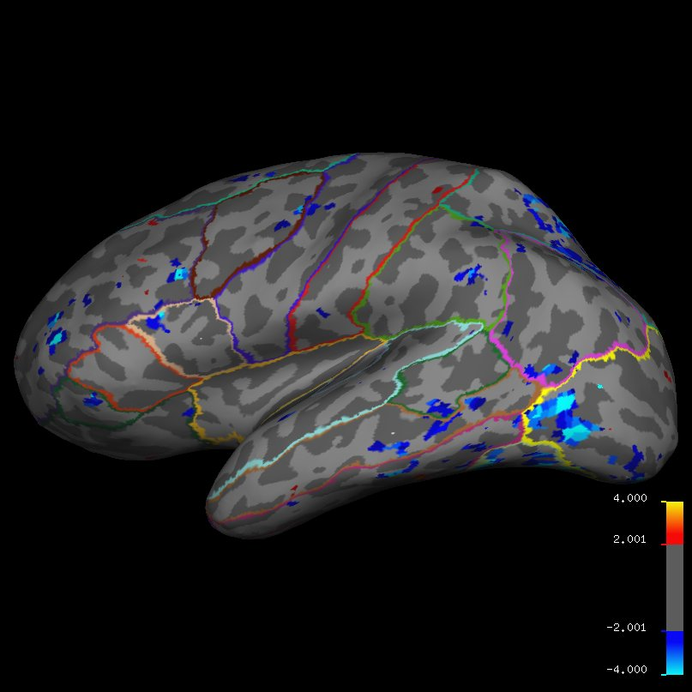
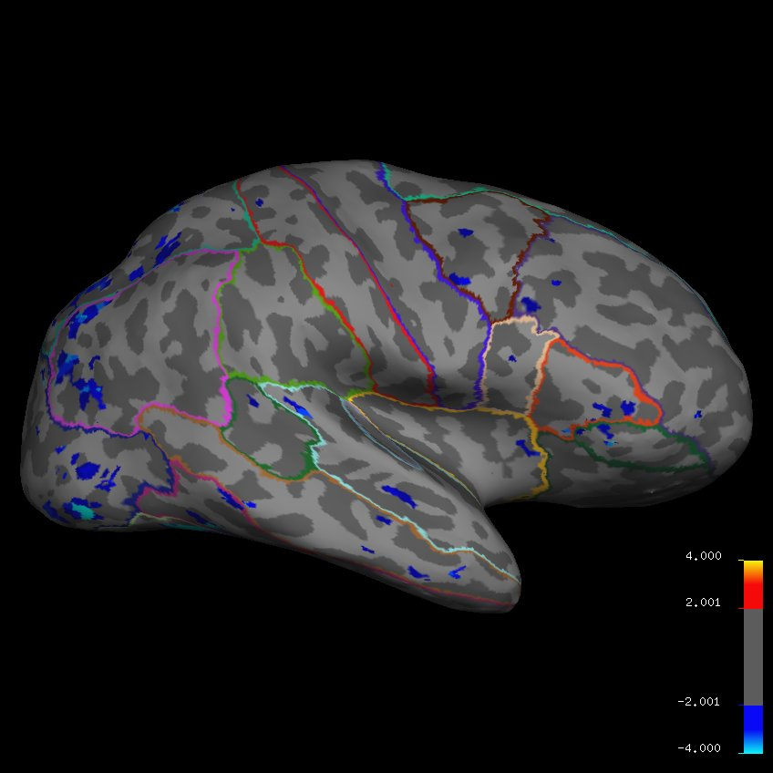
Global vs Local Trials: Blue = more left hemisphere activation

Slide 3
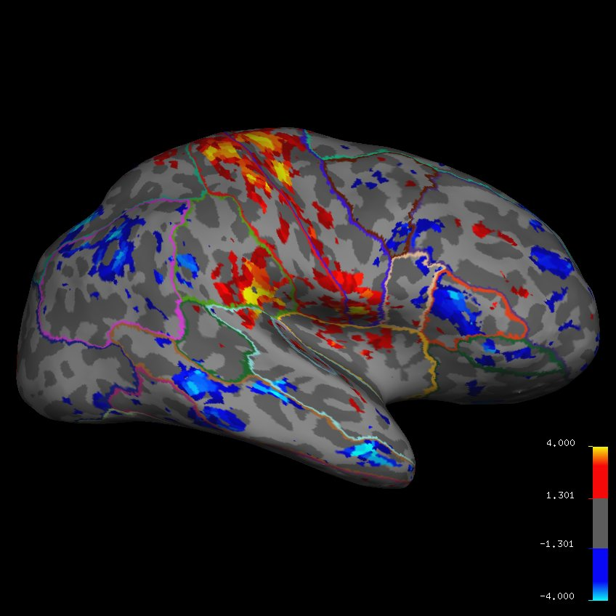
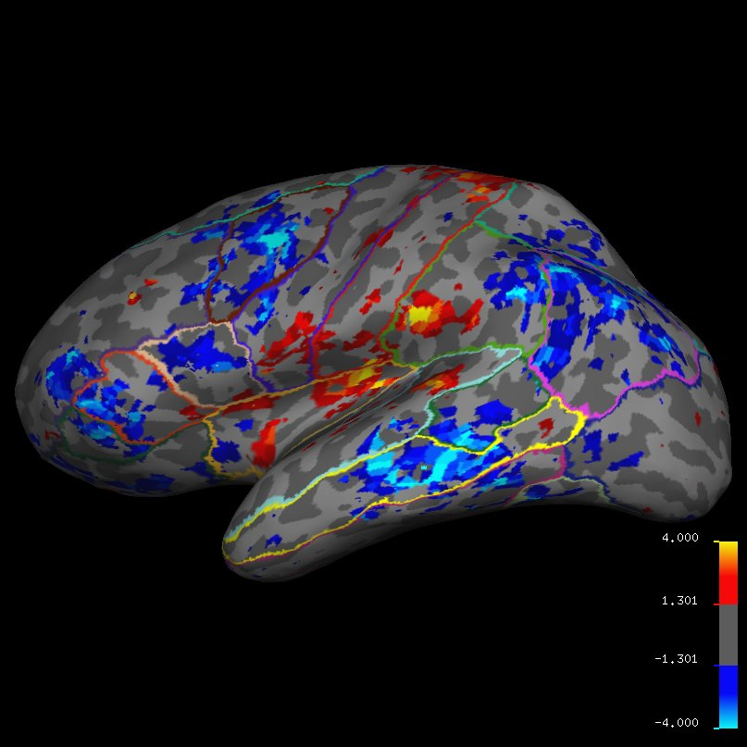
Congruent vs Incongruent: Red= congruent, blue= incongruent

