Slide 1

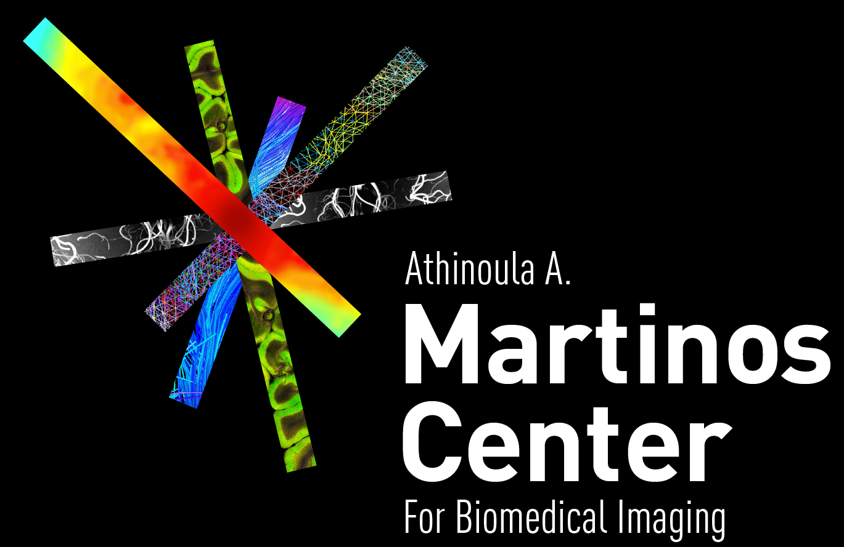

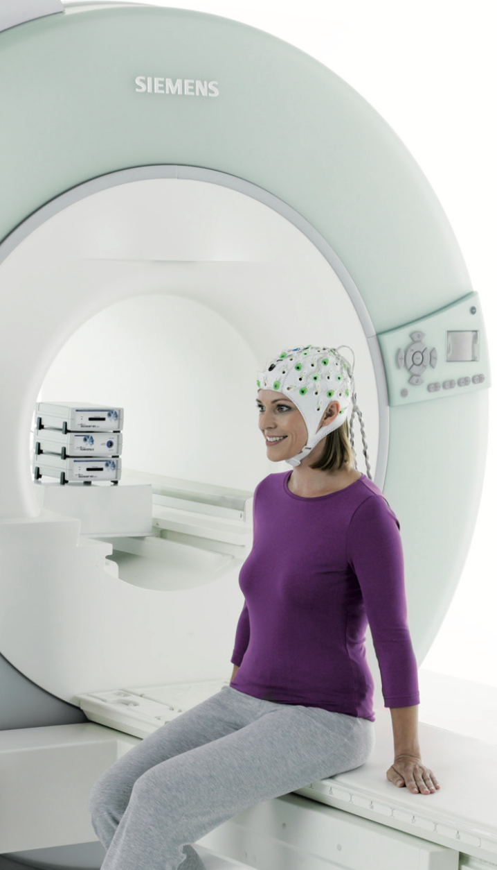
Blood-brain barrier penetrance and neurovascular coupling: a pharmacological comparison of renin-angiotensin system modulators, statins, beta-blockers, and calcium channel blockers
Tatiana Sitnikova
Martinos Center for Biomedical Imaging,
Harvard Medical School and Massachusetts General Hospital
Boston, USA
Image courtesy of Brain Products GmbH
Notes:
These slides were presented as a part of the first Plenary symposium at the 21st International Conference on Biomagnetism held in Philadelphia in August, 2018.

Slide 2
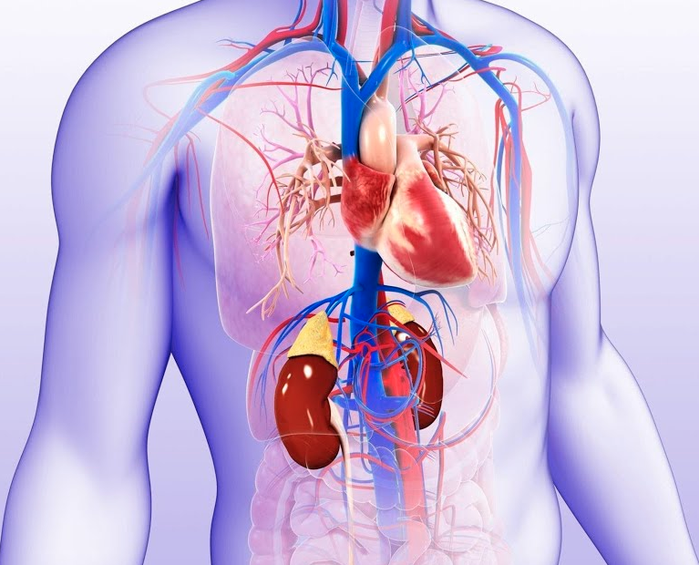
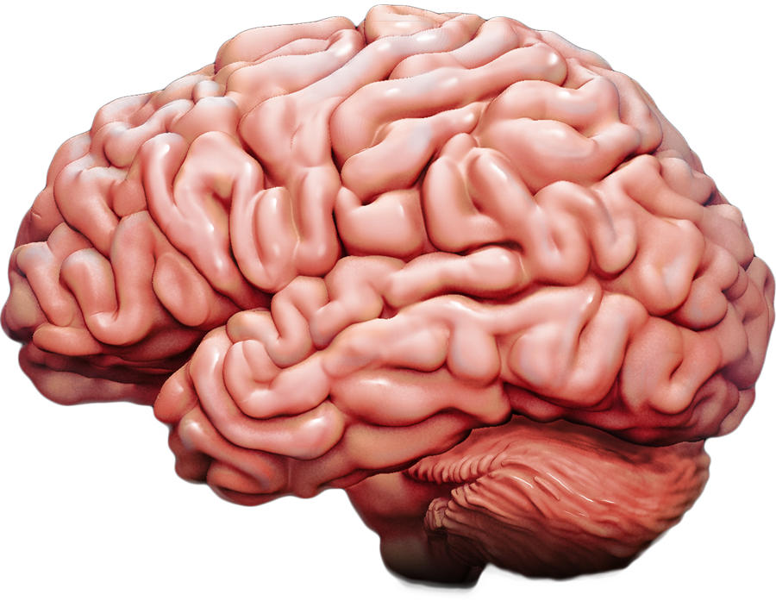

A need to study how medications for the Metabolic Syndrome affect the brain
Blood sugar
Blood pressure
BMI
Cholesterol
Statins
Angiotensin receptor Blockers (ARBs)
Angiotensin converting enzyme (ACE) inhibitors
Calcium Channel Blockers
Notes:
A range of pharmacological treatments has been developed to target the various features of the metabolic syndrome
Unfortunately aging is a risk factor for disease the metabolic syndrome being one of the most common conditions. A polypharmacy of medications has been developed to control blood pressure, cholesterol, and other features of the metabolic syndrome as they are thought precursors to heart and kidney disease. More recently, evidence has accumulated that the metabolic syndrome can also affect cerebrovascular health. In the analyses that I am presenting today, we examined how the medications developed for the metabolic syndrome may one of the most vulnerable vascular brain functions – the neurovascular coupling.
A need to study how medications for the Metabolic Syndrome affect the brain
To immediately orient your audience and give clear direction, your first sentence should act as a strong signpost—it should frame the clinical landscape, hint at your central scientific question, and set up the visual transition from heart to brain.
As we age, we become increasingly susceptible to systemic conditions like the metabolic syndrome — a constellation of cardiovascular risk factors that primary care doctors routinely monitor and treat.
Blood pressure, cholesterol, blood sugar, and BMI are familiar metrics in any clinic — and they are treated aggressively, often with multiple medications, because they are known precursors to heart disease and kidney disease.
But what about the brain? While much of the medical infrastructure is focused on preventing cardiovascular outcomes, growing evidence suggests that these same risk factors — and the drugs used to manage them — may also influence cerebrovascular health.
In this talk, I’ll focus on one particular brain function that’s deeply vascular — neurovascular coupling — and ask: how might commonly prescribed medications affect it?

Slide 3
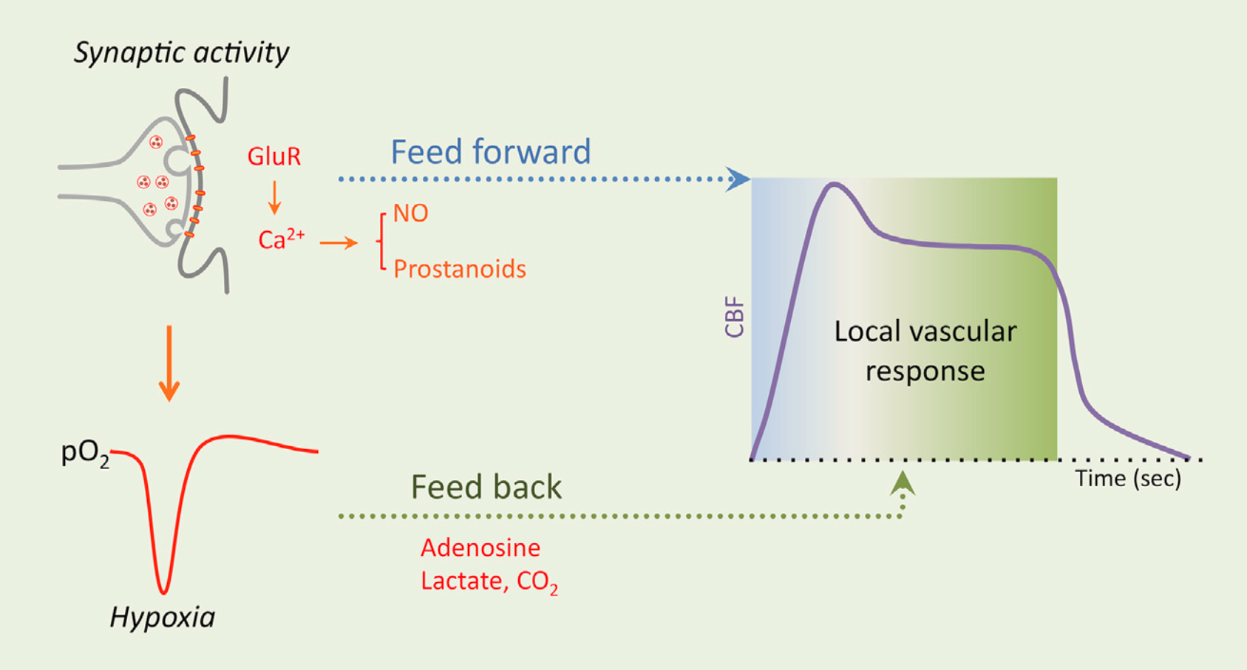
Neurovascular coupling enables timely vascular support of brain activity, with signaling between neurons and endothelial cells confined to the brain side of the blood-brain barrier (BBB).
Iadecola 2017
Notes:
The brain does not store energy reserves. Instead, whenever a network of brain cells becomes active, the released neurotransmitters such as glutamate are also picked up by supporting brain cells astrocytes that through Ca promotes release of NO etc that sygnals to endothelial cells to increase flow and volume of blood to the active brain areas. (neurons send chemical signals) Much of this cascade occurs behind the BBB – thtat is formed by endothelial cells. And. In this talk today we will look at differences between the effects of meds that cross do not cross the BBB. I also want to heads up that given our method measures BOLD change evoked by fast electrophysiological events, it is more likely that we are sensitive to feed forward overdeliveriry of oxygen rather than feed back mechanism. I will show them how fast the events go by.
Neurovascular coupling: a feed-forward signaling cascade linking neurons to blood vessels
The brain is a remarkably energy-hungry organ — yet it stores virtually no reserves.
So when a network of neurons becomes active, it must immediately recruit resources. This process starts when neurotransmitters like glutamate are released into the synapse. These molecules don’t just communicate with other neurons — they also activate astrocytes, the brain’s support cells.
Astrocytes, in turn, trigger a cascade of signaling events, including calcium influx and the release of vasodilators like nitric oxide. These chemical signals ultimately reach the endothelial cells that line the blood vessels — instructing them to rapidly increase local blood flow and volume to support the active brain region.
Importantly, much of this signaling occurs behind the blood-brain barrier (BBB) — and so, in today’s talk, I’ll highlight the distinction between medications that do cross the BBB and those that do not, and how this might influence their effects on neurovascular coupling.
I also want to flag one methodological point up front: the way we measure neurovascular coupling — using fast electrophysiological events and their corresponding BOLD responses — likely makes our assay more sensitive to feed-forward, anticipatory delivery of oxygen than to slower feedback regulation.
In a moment, I’ll show you just how fast these neural and vascular responses unfold.

Slide 4
Disrupted neurovascular coupling may promote beta-amyloid deposition, increasing susceptibility to Alzheimer’s disease
Impaired Neurovascular Coupling
Hypoxia
BACE1 gene transcription/expression
β-cleavage of APP
Amyloid-β overproduction
Reduced vasomotion
Perivascular and glymphatic clearance reduction
Amyloid accumulation
Sun 2006, Santisteban 2024
Notes:
“So why are we so concerned with neurovascular coupling? This slide shows two major mechanisms by which its disruption may contribute to Alzheimer’s disease pathology.
On the one hand, reduced perfusion can lead to hypoxia, which triggers molecular responses such as upregulation of BACE1 — the enzyme responsible for cleaving amyloid precursor protein into amyloid-beta. This results in increased Aβ production. That’s shown in the top part of the slide.
On the other hand, neurovascular dysfunction can impair the clearance of amyloid that’s already present. In particular, reduced vasomotion affects perivascular and glymphatic pathways that are essential for clearing Aβ and tau from the brain’s interstitial space.
So impaired neurovascular coupling affects both the production and removal of amyloid, potentially accelerating pathology. And this is the context in which we’re asking: could medications that improve or impair NVC shift Alzheimer’s risk?”
Hypoxia up-regulated beta-secretase cleavage of APP and amyloid-beta protein production by increasing BACE1 gene transcription and expression

Slide 5
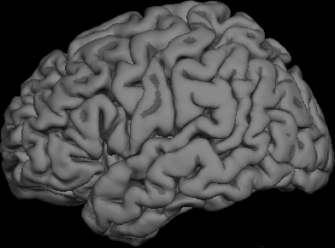
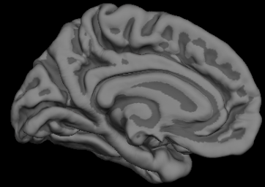



Default Mode Network: High metabolic demand may confer vulnerability to neurovascular coupling disruptions
Connectivity “hubs”
Increased activity on FDG PET
Increased mitochondrial gene expression
Early amyloid accumulation
Buckner 2009,Geary 2021, Palmqvist 2017
Notes:
“To understand why we focused on regions like the precuneus, it helps to look at where amyloid tends to accumulate — and why.
These are regions with high metabolic demand — they’re active on FDG PET, serve as connectivity hubs, and show high mitochondrial gene expression. They’re also rich in horizontal connectivity, making them essential for integration across brain networks.
Because of this, we propose that neurovascular coupling in these regions is uniquely vulnerable — it’s working constantly, dynamically, and under tight energetic constraints.
So if systemic vascular stress interferes with this coupling — especially in areas behind the BBB — it may break most visibly in these demanding regions.
And as I’ll show later, this is where we observe drug-related effects, and where disrupted NVC correlates with performance on dynamic cognitive tasks like backward digit span and visual memory.”
“
But not all brain regions are equally vulnerable. The regions where amyloid tends to accumulate — especially the Default Mode Network — are the same regions that carry the greatest metabolic burden in the healthy brain.
These are regions of high activity on FDG PET, of strong horizontal connectivity and hubness, and of elevated mitochondrial gene expression.
So the way we frame this in our study is not that these regions break down first, but that when the entire brain is under vascular stress from systemic disease, it’s the regions most reliant on intact neurovascular coupling — like the DMN — that are most likely to show downstream pathological consequences, like amyloid accumulation.
And that’s the idea we test in the next set of analyses.”
“When the whole brain is affected by systemic conditions, the Default Mode Network (DMN), due to its high metabolic demands and reliance on neurovascular coupling, is especially vulnerable — and this vulnerability may lead to downstream consequences like amyloid accumulation.”
DMN is most neurally and metabolically active, and we could eaither suggest that "this high demand would make NVC to break"
Several observations suggest that neural activity homeostasis may play a role in Alzheimer’s progression.
A recent animal study in hippocampal slices provided experimental evidence that can help to tie all these previous cues into a mechanistic model.
This study examined the effects of different temporal patterns of stimulation on the production of amyloid-beta, more specifically on the ratio between the shorter protein form AB40 and the longer – pathological form, which is harder to degrade – AB42.
What it found was that, even though increase in activity rate increased AB production, the healthy high ratio of short-to-long protein form was dependent not on the rate of neural activity but on the temporal pattern; the neural activity must come in high-frequency bursts rather than in isolated spikes. In AD, dysregulation of bursting activity patterns may lead to overproduction of pathological AB42 in the high activity brain regions.
It is tantalizing to translate such findings to clinical research in humans, but there are still a great number of assumptions – not supported by experimental evidence. In particular, the temporal component has not been extensively studied, as much research in humans was done with fMRI, relying on slow blood flow changes for inferences about neural activity.
To help in bridging this gap, our efforts have been directed at using non-invasive imaging in humans with high temporal resolution, to study fast temporal patterns of activity in large-scale networks.
********************
Regions (DMN/hippocampus) of Amyloid-Beta accumulation overlap:
[1] regions that show increased spontaneous neural activity and metabolic demand in neuroimaging of the healthy brain;
[2] regions that participate in multiple functionally specific neural networks as revealed in structural and functional connectivity imaging studies of the healthy brain;
[3] regions that in animal and computational neuroscience studies have been shown to have heightened horizontal connectivity, enabling sustained spontaneous synchronized neuronal firing;
[4] regions where burst patterns of neural firing are more prevalent (Associative cortex: 50% of neural discharges in bursts vs. 80% isolated spikes in sensory cortex)
&&&&&&&&&&&&&&&&&
Tantalizing recent evidence in the animal model: in hippocampal neurons, Amyloid-Beta production increases with increased activity and Amyloid-Beta aggregation occurs with chronic activity increases via optogenetic stimulation; BUT natural burst patterns (and even activity patterns in regular bursts of > 10Hz) are protective against over-production of long-protein type of Amyloid-Beta (Aβ42 ) which is most prone to aggregation in the brain.

Slide 6
The study hypothesis:
Neurovascular coupling within the Default Mode Network will differ between individuals with metabolic syndrome treated with BBB-penetrant medications and those treated exclusively with non–BBB-penetrant agents.
Notes:
Based on the prior evidence I just summarized—which both motivates and constrains the scope of our study—we formulated the following hypothesis
We expected that neurovascular coupling in the Default Mode Network will be modulated by blood–brain barrier penetrance of prescribed medications. To test this hypothesis we compared patients with metabolic syndrome treated with BBB-penetrant agents to those receiving only non–BBB-penetrant drugs.”
“Neurovascular coupling in the default mode network will differ between individuals with metabolic syndrome who are treated with blood-brain barrier–permeable medications versus those treated only with blood-brain barrier–impermeable medications.”

Slide 7
Methods
Observational study:
Blood-Brain Barrier Permeable (BBB+)
ACE Inhibitors
Lisinopril
ARBs
Valsartan
Statins
Atorvastatin
Simvastatin
Beta-Blockers
Carvedilol
Metoprolol
Blood-Brain Barrier Impermeable (BBB-)
ARBs
Losartan, Irbesartan
Statins
Rosuvastatin
Pravastatin
Calcium Channel Blockers
Amlodipine
Diuretics
Hydrochlorothiazide
85 older adults
50% female
Age 55-80 years
40 participants on metabolic syndrome medications
Patient subgroups
[1] take BBB+
[2] ONLY on BBB-
Age, sex, diagnosis matched
Ho 2021
Notes:
“Our sample included 85 older adults aged 55 to 80, with about half being female. Forty of these participants were being treated with medications commonly prescribed for metabolic syndrome—such as antihypertensives, statins, and diuretics—which are listed on the right. Importantly, these medications differ in whether or not they cross the blood-brain barrier, which forms the basis of our subgroup analysis.”
“We studied 85 older adults between the ages of 55 and 80. About half were on medications typically prescribed for the metabolic syndrome, such as blood pressure meds, statins, and diuretics — with an even split by gender.
All participants underwent simultaneous EEG and fMRI, allowing us to assess neurovascular coupling — that is, how fast neural events give rise to vascular responses — in a resting state.
Our key manipulation was whether participants were taking medications that cross the blood-brain barrier or not. On the right, you can see how we categorized the drugs into BBB-permeable (BBB+) and non-permeable (BBB−) classes.
Our model: Drug BBB access → NVC modulation → Cognitive function - Endothelial-only effects are not targeted by this framework - They represent noise, not signal, in our analysis

Slide 8
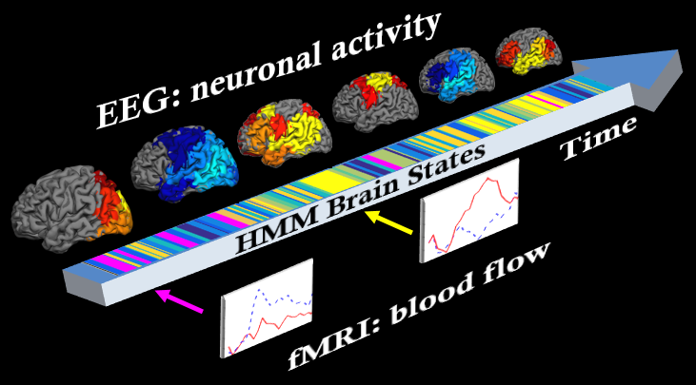
Neurovascular Coupling :
Simultaneous electroencephalography (EEG) and functional magnetic resonance imaging (fMRI)
4-second-long sample data
Neural activity:
EEG electrophysiology
Hidden-Markov Modeling (HMM)
Blood flow and volume:
fMRI Blood Oxygenation Level Dependent (BOLD)
Finite Impulse Response (FIR) deconvolution
Image courtesy of Brain Products GmbH
Notes:
To quantify neural activity, we used EEG to capture fast electrophysiological signals arising from coordinated neuronal firing. To measure the corresponding vascular response, we used fMRI to track the BOLD signal, which reflects increases in cerebral blood volume and flow—and the resulting overflow of oxygen—into the active brain region.

Slide 9
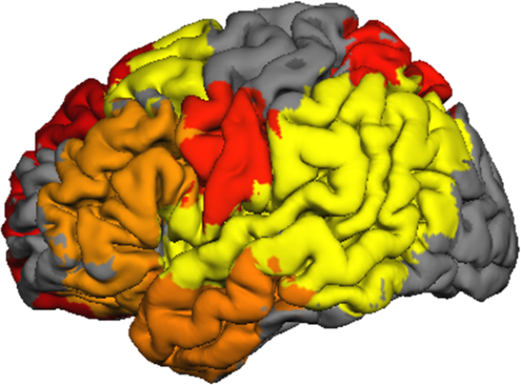
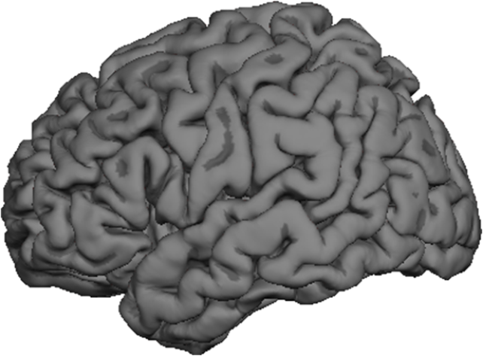
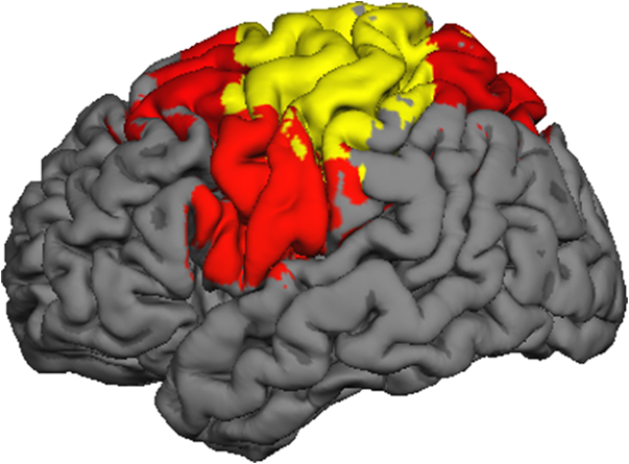
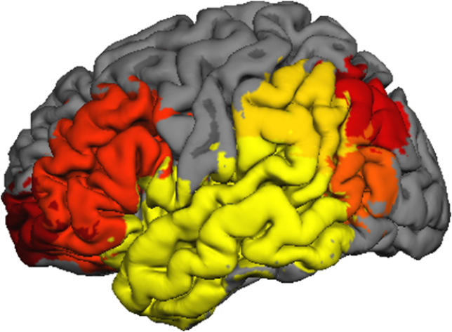
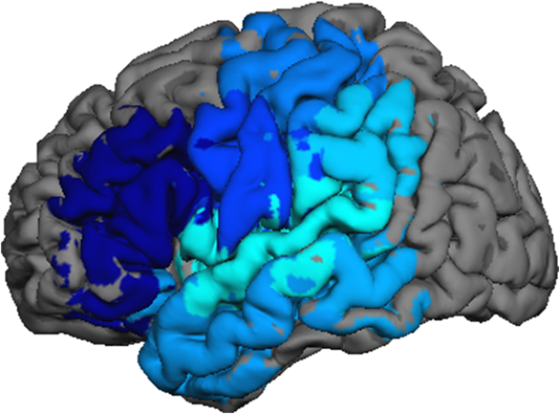
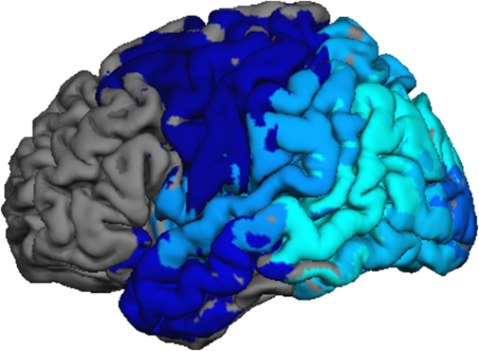
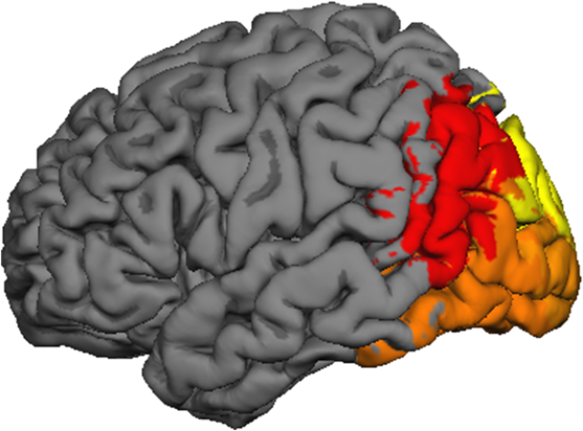
Fast train of electrophysiological network activations
Time, 1-sec-long
Time
Notes:
The HMM analysis of the MEG data suggests that spontaneous brain activity consists of a jittered sequence of brief activity changes in unique large-scale neural networks.
Here is how it might look in real time.
&&&&&
Here is what the cutting-edge analysis of the MEG data bought us!
We were able to see spatiotemporal patterns of oscillatory bursts – here is how it might look in real time.
Colors on the arrow represent timing of different spatial activity patterns.
From the pattern overlapping the default mode network (for 250ms; DMN) to the visual network pattern (for 90ms; VisN) to language network (LNG) to dorsal attention network (DAN), to right-lateralized activation, to sensory motor network (SMN) to left-lateralized associative network (LAN), to a recurring visit to the DMN …

Slide 10
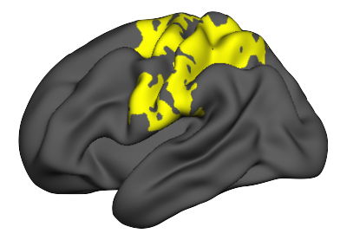
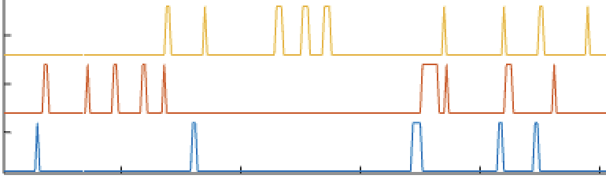
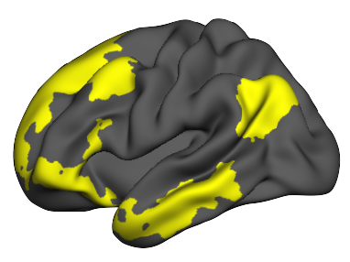
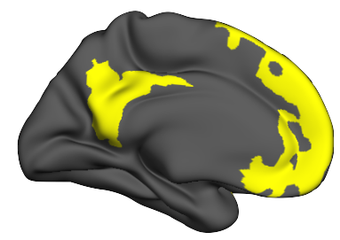
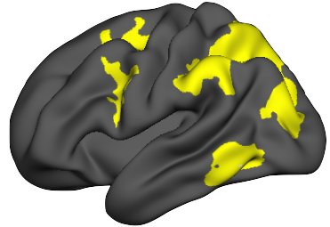
Vascular responses to spatially distinct EEG states were localized to previously described functional brain networks
Sensorimotor
EEG/HMM
Time: 5 sec
Default Mode
Evoked fMRI
SMN
DMN
DAN
Dorsal Attention

Slide 11
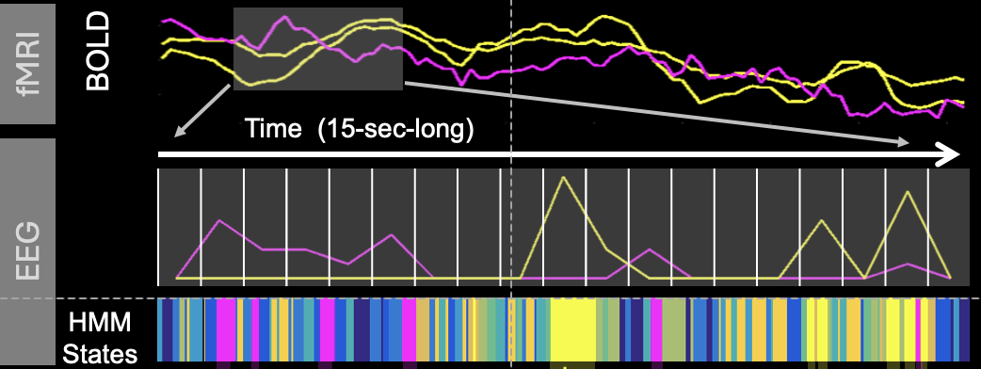
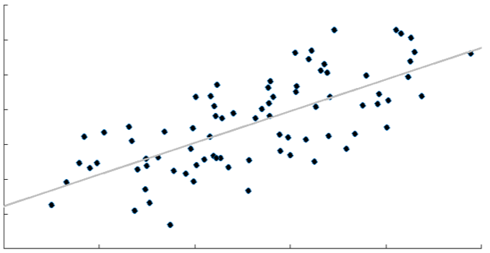
Neurovascular Coupling in Default Mode Network:
Rate of increase in vascular signal per unit increase in neural signal
In each brain voxel, at each deconvolved time point:
fMRI == vascular
EEG == neural

Slide 12
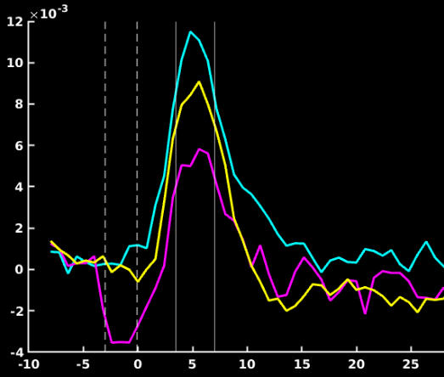
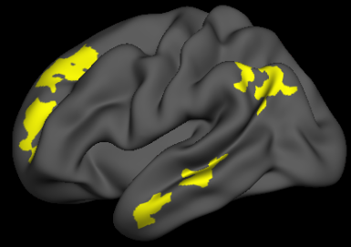
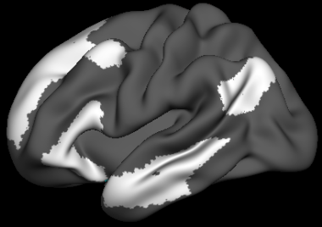
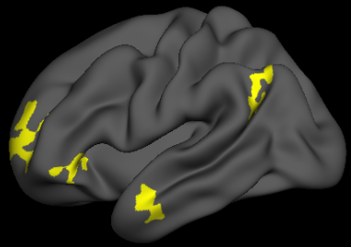
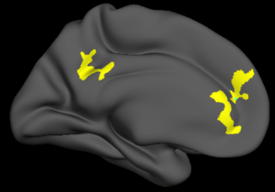
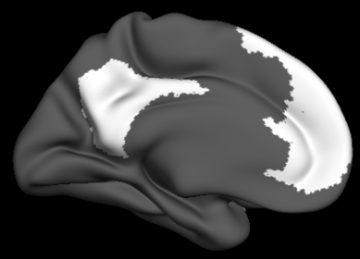
Results: In the Default Mode Network, neurovascular coupling was stronger in patients taking BBB+ meds relative to those treated only with BBB- meds
Used BBB permeable
Healthy control
Only BBB impermeable
Neurovascular coupling (lateral parietal)
Time, sec
Notes:
When we averaged the voxelwise responses across Default Mode Network regions derived from an anatomical atlas, we observed that consistent with prior research on the neurovascular coupling, the peak of the neurovascular response, occurred around 5 seconds post-event.
At this peak, patients taking blood-brain barrier (BBB)–permeable medications exhibited stronger neurovascular coupling than those on BBB-impermeable medications.”
“To complement the ROI-based analysis, we next conducted an exploratory whole-brain voxelwise comparison to identify where neurovascular coupling differs between the BBB+ and BBB− groups. We restricted this analysis to the time interval around the 5-second peak established in the prior analysis.
To correct for multiple comparisons, we used a Monte Carlo simulation approach, identifying clusters of voxels where group differences were unlikely to occur simply by chance.
The resulting clusters again localized to regions within the Default Mode Network, reinforcing the specificity of the effect.”

Slide 13
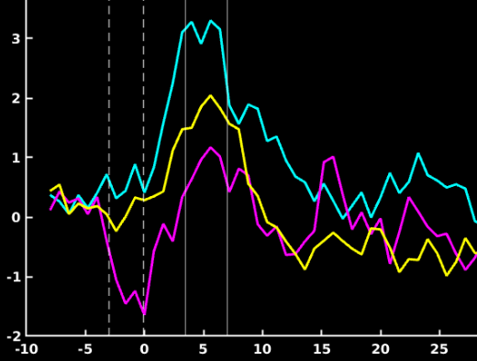
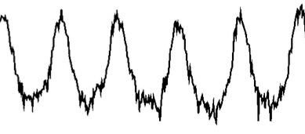





In patients treated only with BBB- meds, slow oscillations may govern when the DMN activations can occur
Slow oscillations in:
The vascular tone (.01-.1 Hz)
Arterial pressure (~.1 Hz)
Cortical excitability (< .05 Hz)
Time, sec
Sassaroli 2012, He 2008
Notes:
Vasomotion is strictly defined as an oscillation in the vascu- lar tone, which causes the cross section of the blood vessels to

Slide 14
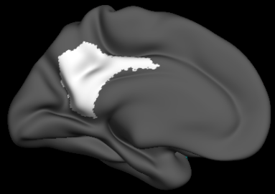
In precuneus — a major hub of neural communication — neurovascular coupling in patients taking BBB+ meds was also stronger relative to healthy controls
Used BBB permeable
Healthy control
Only BBB impermeable
Neurovascular coupling (lateral parietal)
Time, sec
Yamaguchi 2024, Luber 2007
Notes:
The precuneus hub – role in early AD - dynamic integration of information fMRI and TMS – spatial updating attention reorienting and working memory.
Several studies using fMRI and repetitive transcranial magnetic
stimulation (rTMS), a procedure to stimulate the brain surface by
magnetic pulses, have shown that the precuneus is associated with a role
in spatial attention and spatial updating (Mahayana et al., 2014; Müller
et al., 2018; Wolbers et al., 2008).
Attention reorientation task
Numssen 2021
DVMT connectivity of precuneus Cui 2024
Bai 2021 drawing tasks

Slide 15

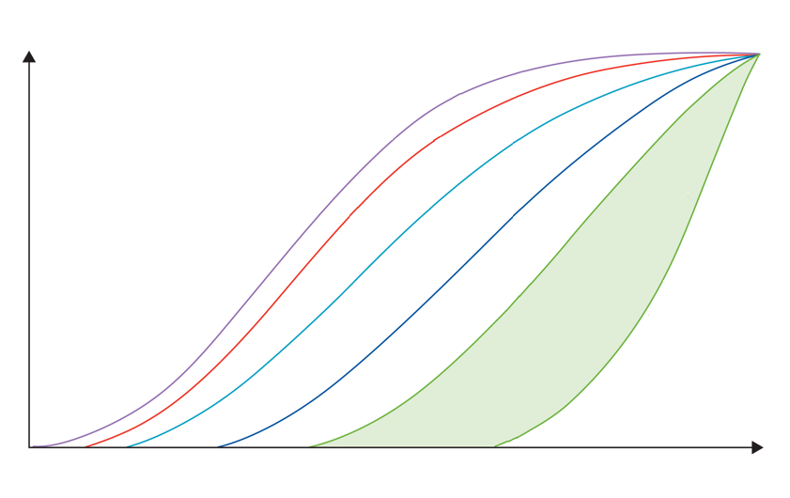
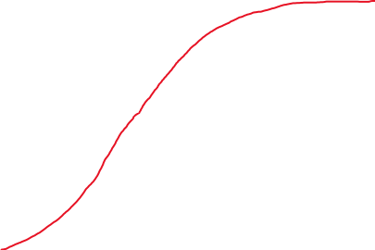
Cascade of pathological processes in Alzheimer’s disease can be modeled by dynamic biomarkers (Jack et al, 2013)
Was episodic memory affected by neurovascular coupling in default mode network?
max
Cerebrovascular disfunction
Cognitive impairment
Pathology level
Cell damage: MRI + FDG PET
CSF Aβ₄₂
Amyloid PET
CSF tau
Time
10-20 years
Iturria-Medina 2017
Notes:
A currently accepted model of AD poses a cascading failure in proteostasis of two proteins, Amyloid-Beta, and Tau, which leads to brain cell damage and cognitive impairment.
If dysregulated neural activity contributes to triggering this pathology, early detection and treatment of the dysregulation may prevent or delay onset of AD.
Cascade of pathological processes in Alzheimer’s disease can be modeled by dynamic biomarkers (Jack et al, 2013)
This slide gives a brief overview of Alzheimer’s dementia which is a neurodegenerative disease leading to severe memory impairments.
A recent model summarized our current understanding of Alzheimer’s as a set of staggered overlapping pathologies.
Decades before any noticeable problems with memory, a protein called Amyloid-Beta starts to be aggregated in the brain. Traditionally, this pathology had been assessed indirectly by measuring concentration of this protein in the cerebrospinal fluid (CSF), but more recently amyloid imaging using positron emission tomography (PET) revealed how Amyloid-Beta depositions progress in different brain regions over time.
Another protein, tau, accumulates in the brain with some delay, and as these molecular protein pathologies worsen, damage to neurons and their processes becomes visible on the magnetic resonance imaging (MRI) scans revealing brain atrophy and PET fluorodeoxyglucose (FDG) scans revealing altered metabolic demand of the tissue.
The brain regions impacted by these pathologies include the so called default mode network (DMN) of the brain and the brain structure called hippocampus – which are known neural substrates of memory. Nonetheless, it is not fully understood how the brain pathologies may cause deficits in memory as there is considerable variability in the timing of onset of cognitive impairment (thus, shaded green area on the diagram).
Unfortunately, it is presently highly controversial whether pharmacological removal of Amyloid-Beta and Tau protein deposits from the brain can slow down cognitive impairment.

Slide 16
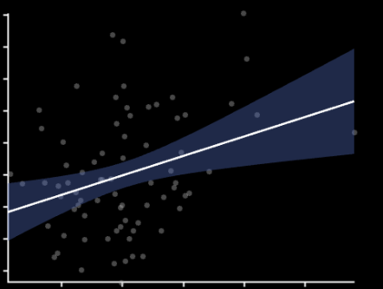
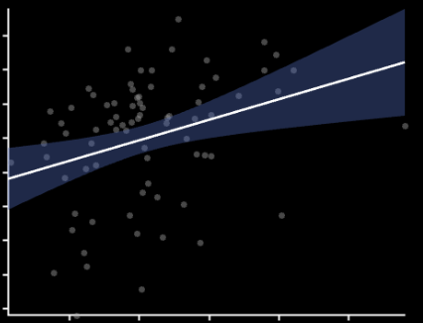
In precuneus — a major hub of neural communication — neurovascular coupling predicted working memory and visuospatial learning
WAIS-IV Digit Backward Span Test
Brief Visuospatial Memory Test
Cognitive performance
Cognitive performance
Neurovascular coupling
Neurovascular coupling
Yamaguchi 2024, Luber 2007
Notes:
transcranial magnetic
stimulation (rTMS), a procedure to stimulate the brain surface by
magnetic pulses, have shown that the precuneus is associated with a role
in spatial attention and spatial updating (Mahayana et al., 2014; Müller
et al., 2018; Wolbers et al., 2008).
– spatial updating attention reorienting and working memory
While more well established role of precuneus is in episodic memory, there is extensive evidence for a time gap between early functional impairment and cognitive symptoms. Thus, in addition to memory we wanted to look at the most demanding dynamic tasks Dynamic cognitive processing for dynamic NVC – supporting fast electrophysiological states; tasks mimicking fast states; episodic memory is a delayed sign of functional disfunction in DMN

Slide 17
Conclusions
1. Blood-brain barrier–penetrant medications prescribed for features of the metabolic syndrome — including statins, RAS modulators, beta-blockers, and calcium channel blockers — may strengthen neurovascular coupling within the default mode network.
2. This effect may support brain health, as preclinical evidence suggests that impaired neurovascular coupling is an early contributor to Alzheimer’s disease.
3. Enhanced neurovascular coupling was associated with better working memory and spatial learning performance, highlighting its functional significance.
4. If replicated in prospective trials, these findings may inform medication selection for individuals with metabolic syndrome to reduce risk of cognitive decline.

Slide 18






Acknowledgements
This research was supported by grants AG075753 and AG072277 from NIH. R01 AG075753
This research at the Athinoula A. Martinos Center for Biomedical Imaging used resources provided by the Center for Functional Neuroimaging Technologies, P41EB015896, the National Institute of Biomedical Imaging and Bioengineering (NIBIB), and by the NIH Shared Instrumentation Grant Program and/or High-End Instrumentation Grant Program; specifically, grant number(s) S10RR014978, S10RR021110, S10RR023401, S10RR019307, S10RR019254, S10RR023043.
Julian B. B. Beckmann, Ph.D.
Nika Ghavamizadeh
Sarah Mellen
David Salat, Ph.D.
Hannah Weibley
Gayathri Vijayaraghavan

